Slide 1
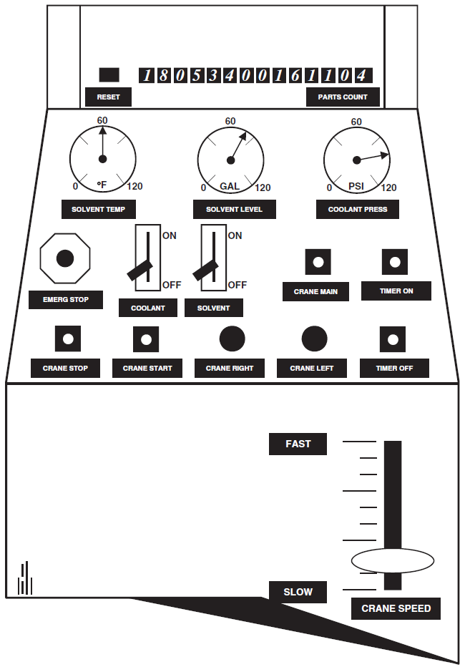
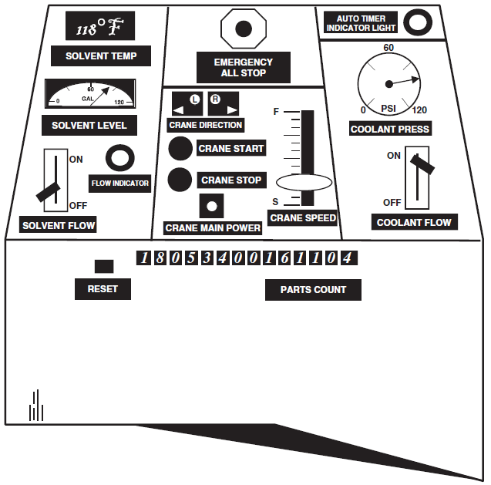
Case Study
Please tell what's wrong with the original design and explain what component arrangement principles are followed for what components in the improved design.
Answer the question concisely.
Source: Jeffrey W. Vincoli. Basic Guide to System Safety. Hoboken,New Jersey: John Wiley & Sons, Inc., 2014. p105
Improved Design
Original Design

